Slide 1


Slide 2


Slide 3
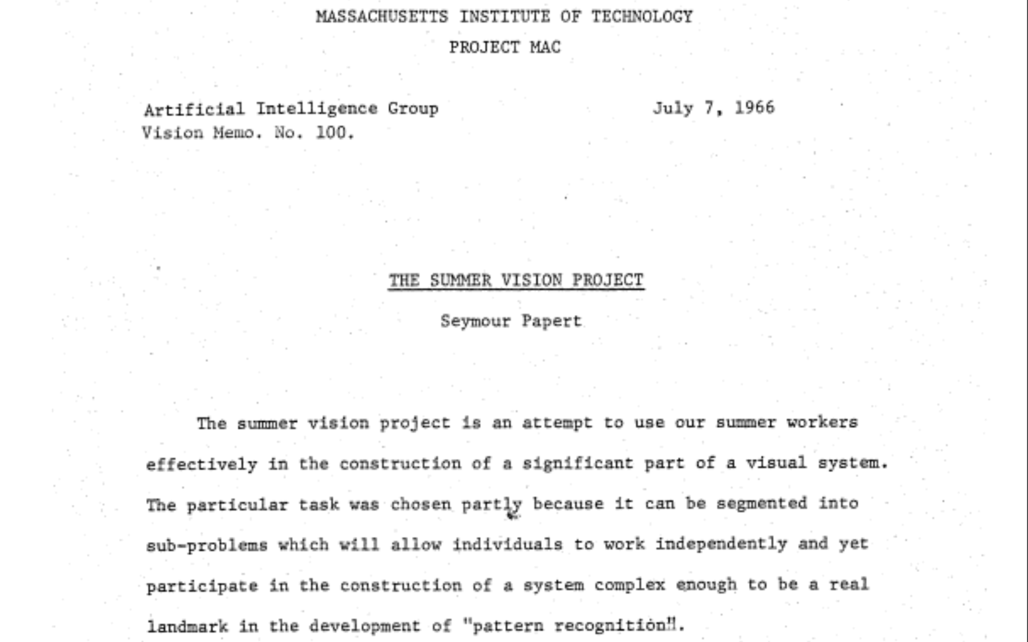

Slide 5
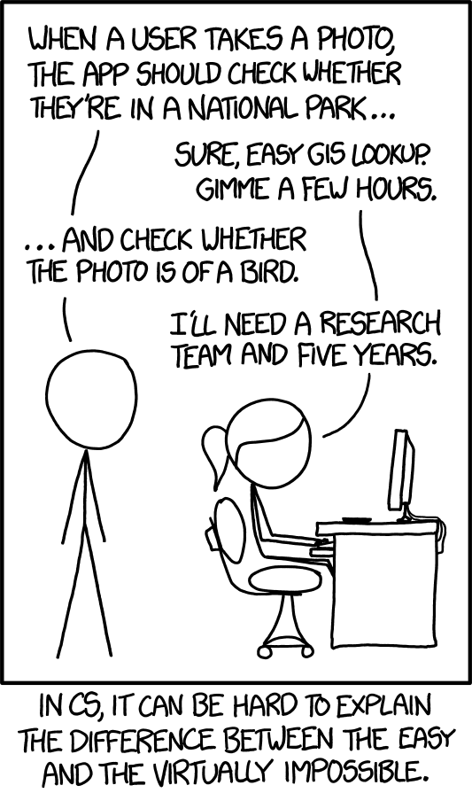

Slide 6

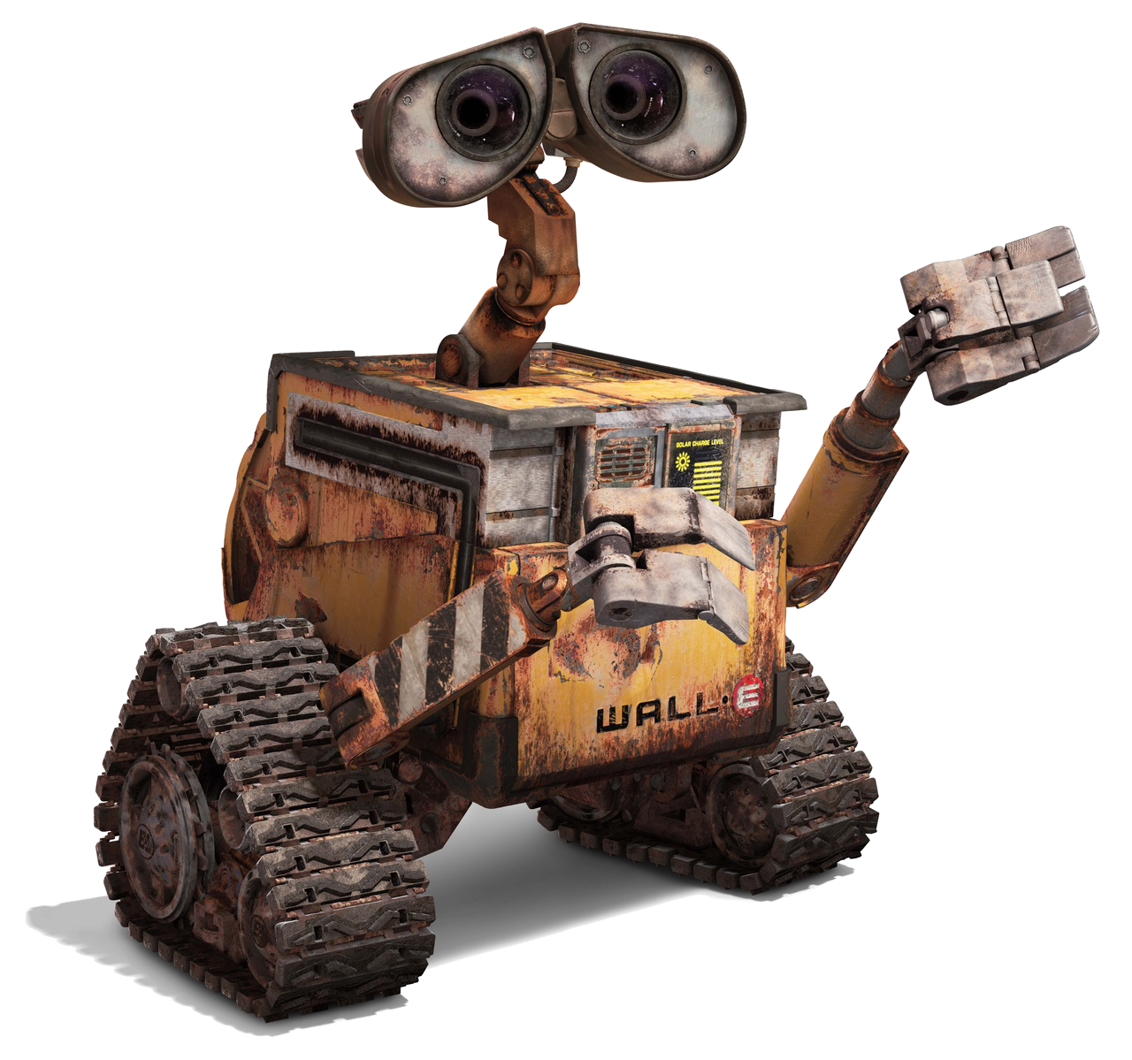

Computer Vision

Slide 7
What does WALL-E see?

Slide 8
Low-Level: Resizing

Slide 9



Low-Level: Resizing

Slide 10
Low-Level: Image Adjustments

Slide 11
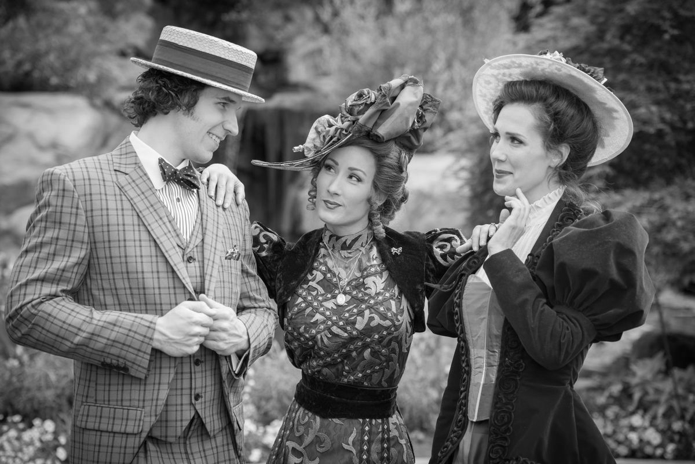
Low-Level: Grayscale

Slide 12

Low-Level: Exposure

Slide 13
Low-Level: Saturation

Slide 14
Low-Level: Hue

Slide 15
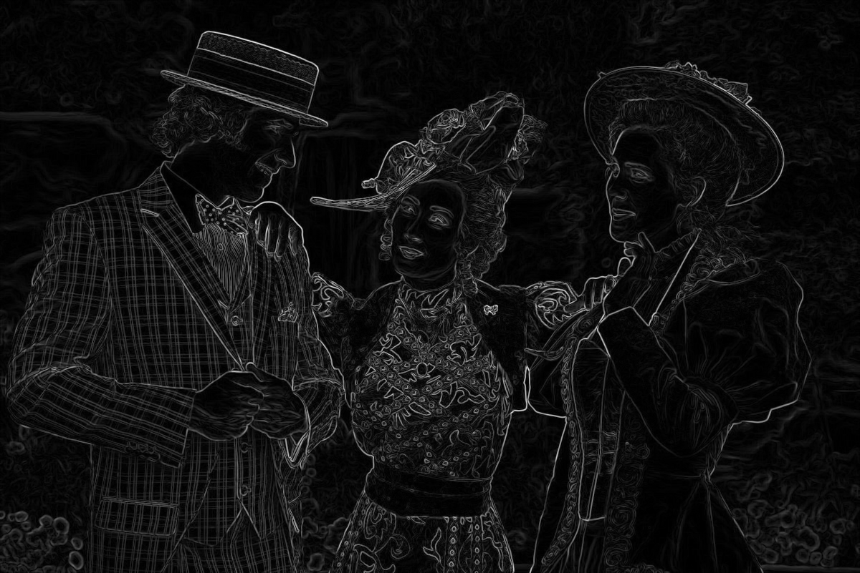
Low-Level: Edges

Slide 16
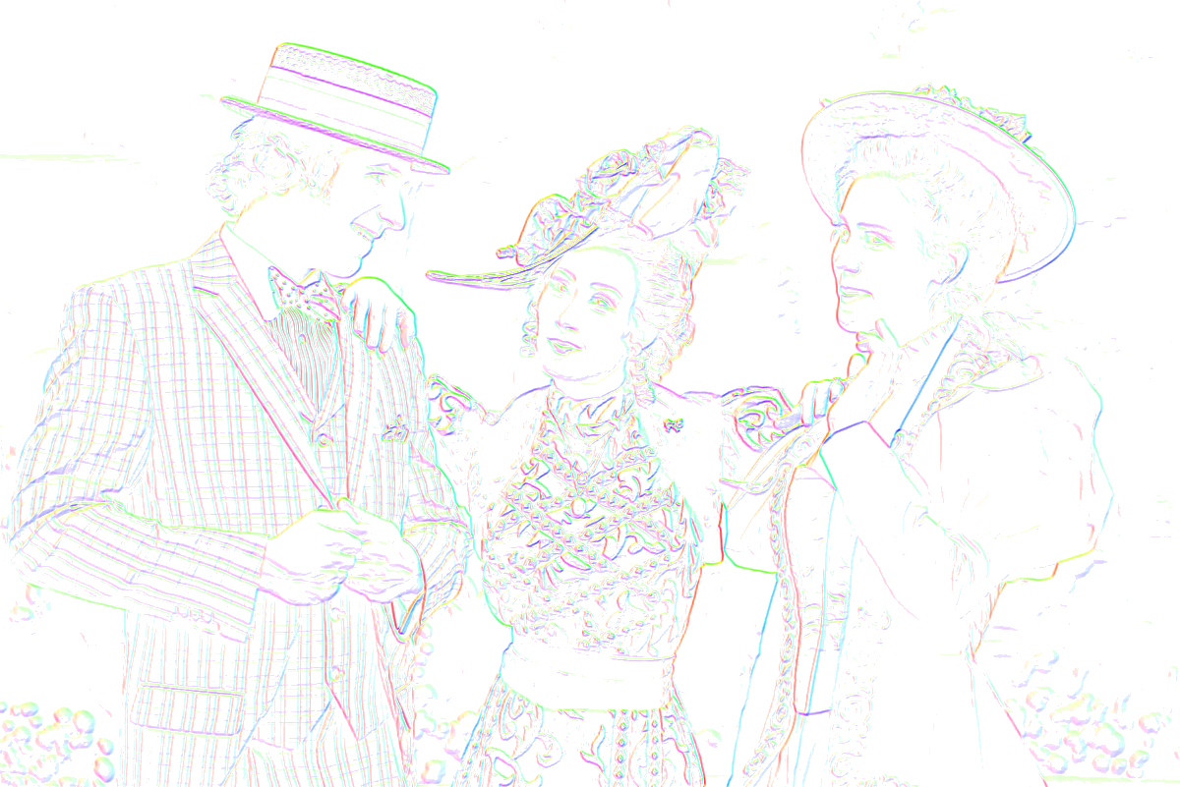
Low-Level: Oriented Gradients

Slide 17
Low-Level: Oriented Gradients

Slide 18

Low-Level: Segmentation (color)

Slide 19
Low-Level Vision
Photo manipulation
Size
Color
Exposure
X-Pro II
Feature extraction
Edges
Oriented gradients
Segments
Low level vision is exciting!!! #latergram #nofilter

Slide 20
Low-Level Vision Applications?
Anyone?

Slide 21
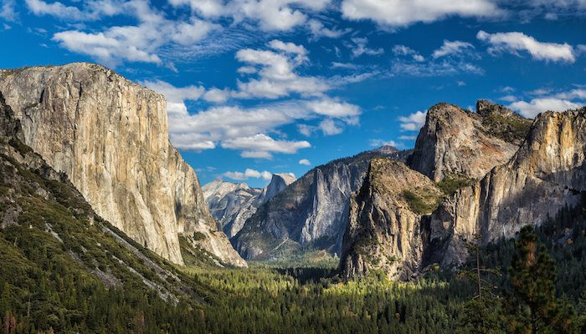

Mid-Level Vision

Slide 22
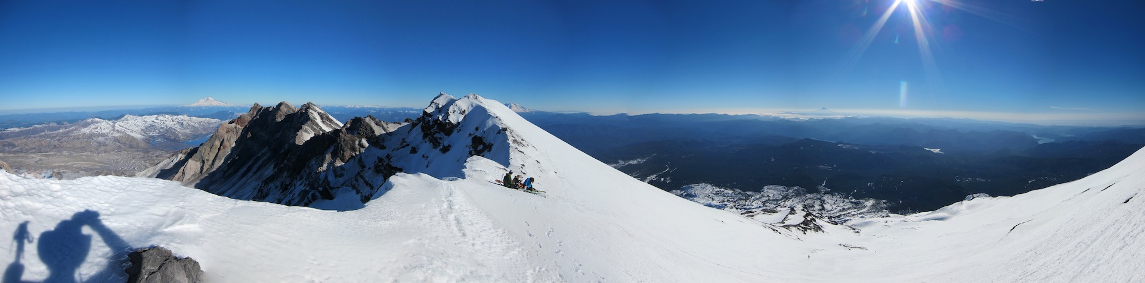
Mid-Level: Panorama Stitching

Slide 23
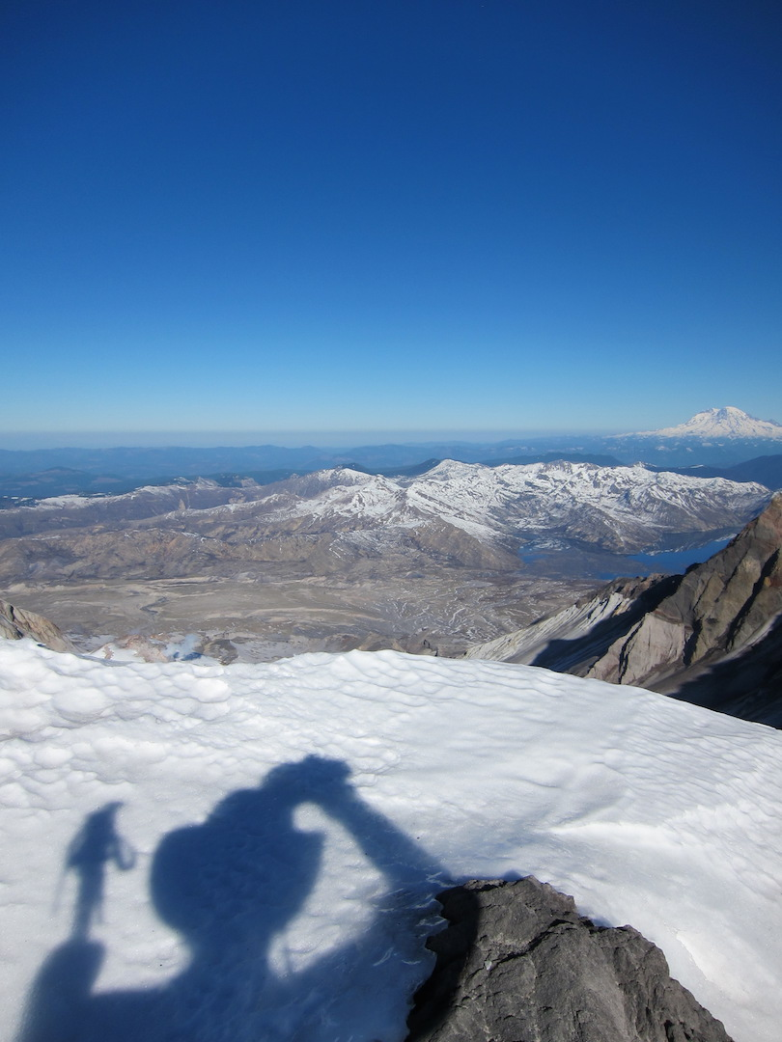

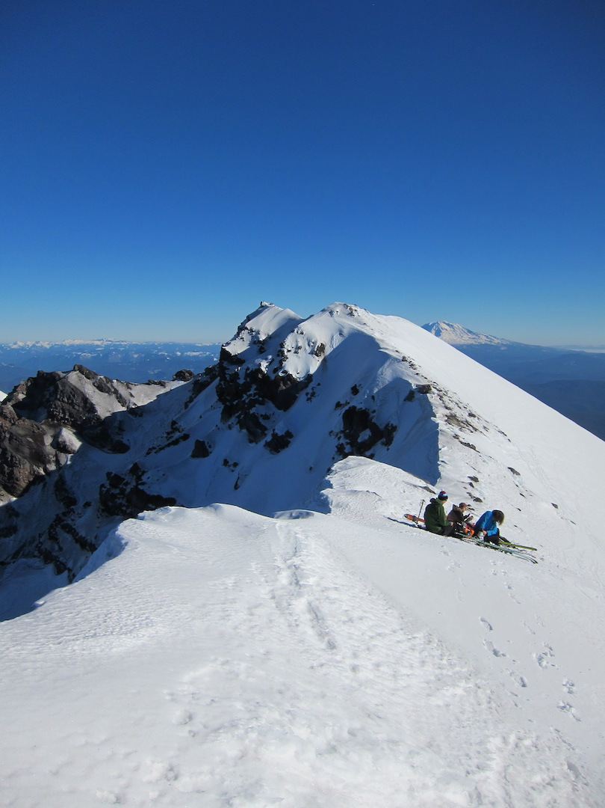
Mid-Level: Panorama Stitching

Slide 24
Mid-Level: Panorama Stitching

Slide 25

Mid-Level: Multi-View Stereo

Slide 26
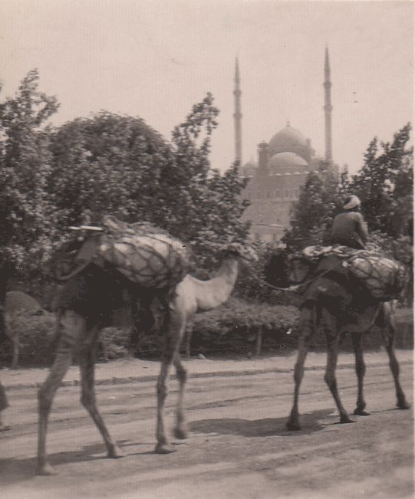
Mid-Level: Multi-View Stereo

Slide 27
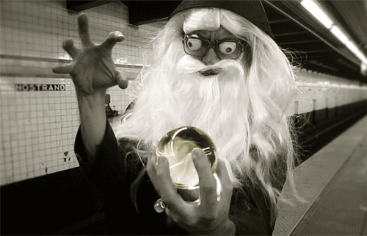
Mid-Level: Multi-View Stereo

Slide 28
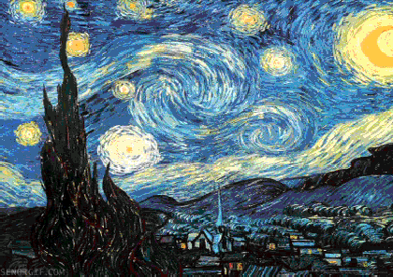
Mid-Level: Multi-View Stereo

Slide 29

Mid-Level: Structured Light Scan

Slide 30
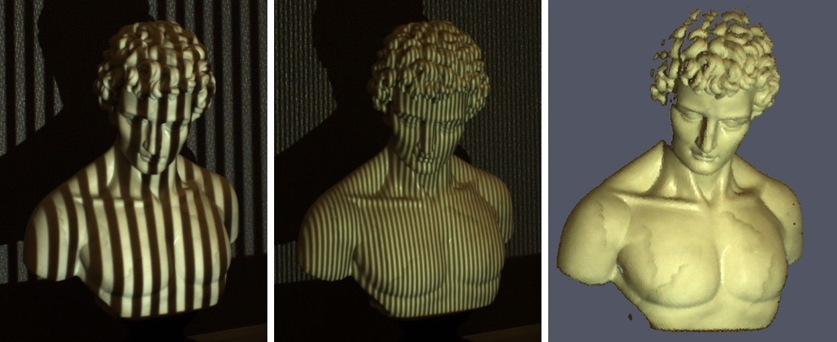
Mid-Level: Structured Light Scan

Slide 31
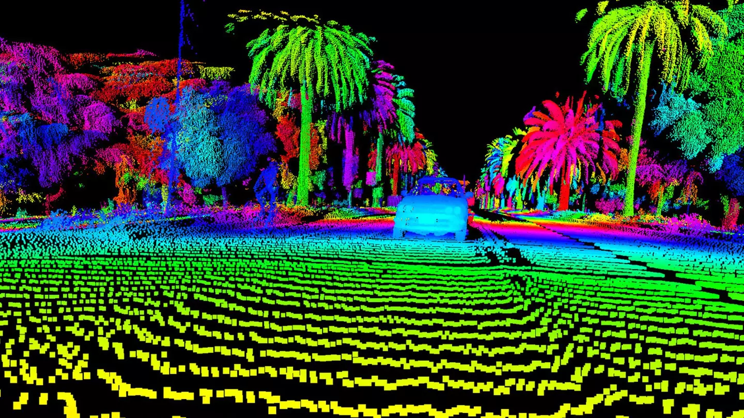
Mid-Level: Range Finding

Slide 32
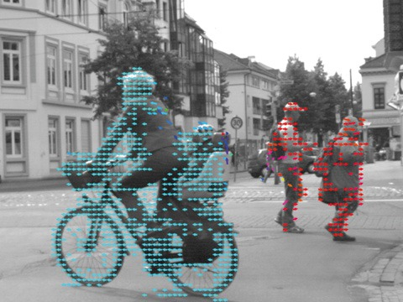
Mid-Level: Optical Flow

Slide 33
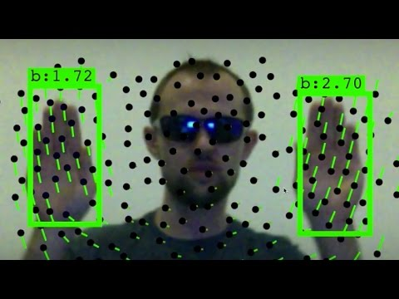
Mid-Level: Optical Flow

Slide 34

Mid-Level: Time Lapse

Slide 35
Mid-Level Vision
Image <-> Image
Panoramas
Image <-> World
Multi-view stereo
Structure from motion
Structured light
LIDAR
Image <-> Time
Optical flow
Time lapse

Slide 36
High-Level Vision

Slide 37
High-Level: Classification
What is in the image?

Slide 38
High-Level: Tagging
What are ALL the things in the image?

Slide 39
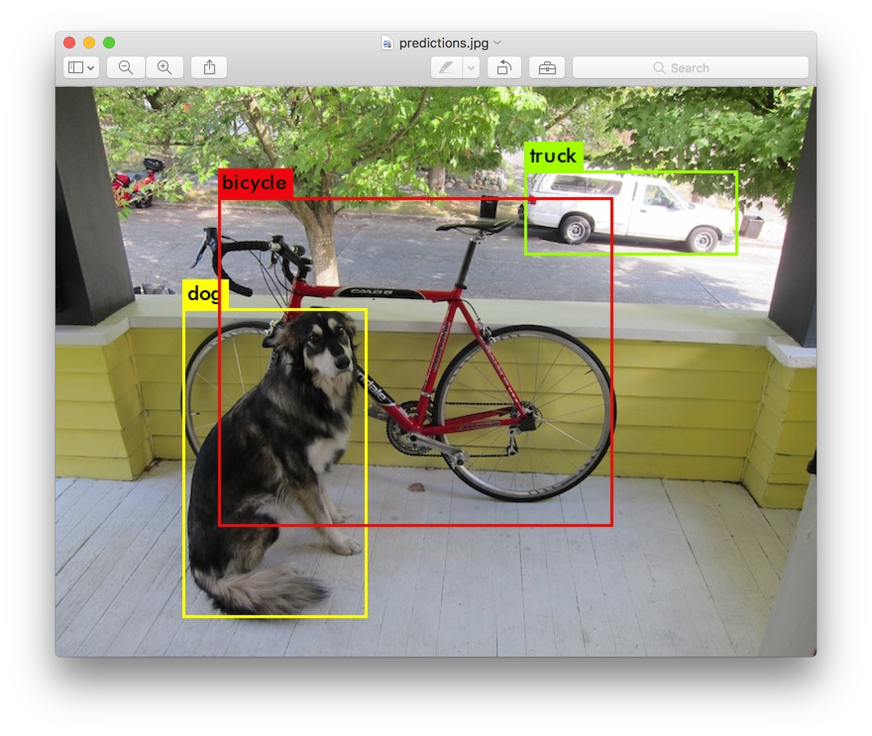
High-Level: Detection
What are ALL the things in the image?
Where are the?

Slide 40
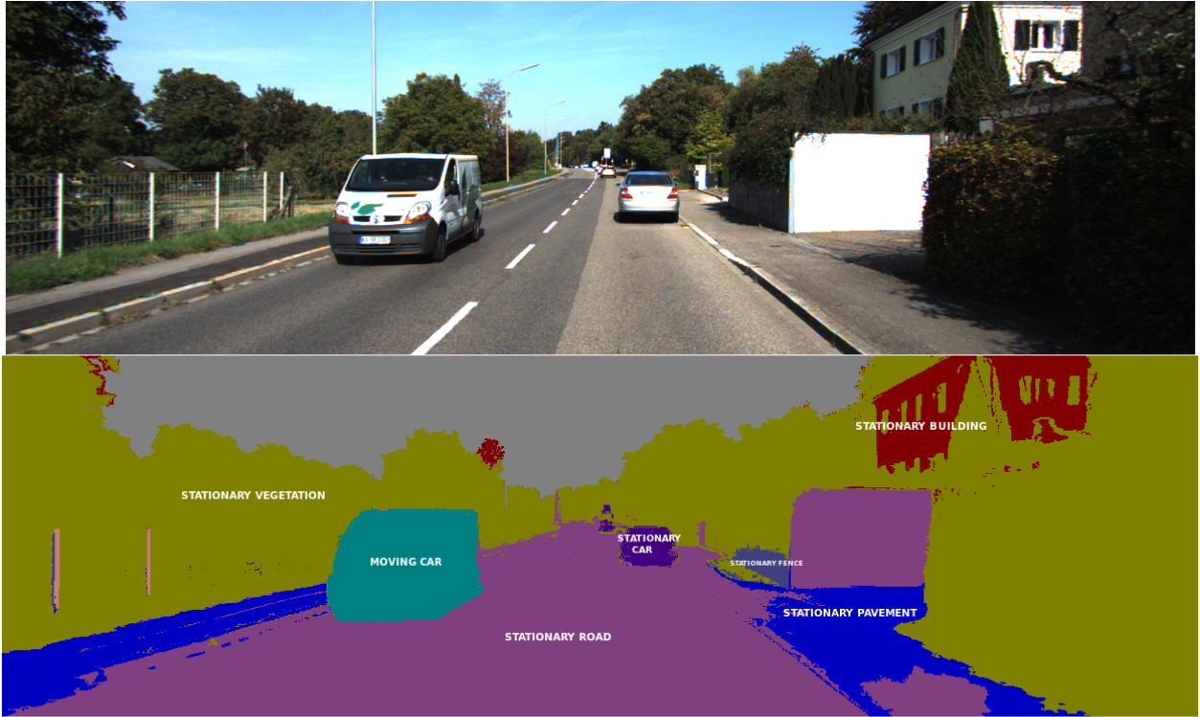
High-Level: Semantic Segmentation

Slide 41
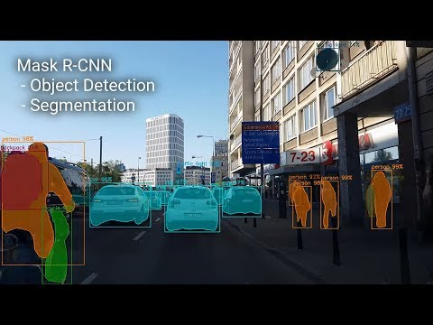
High-Level: Instance Segmentation

Slide 42
High-Level: So many other things
Single image 3D
Game playing
Super-resolution
Retrieval
Other cool things, yay!

Slide 43
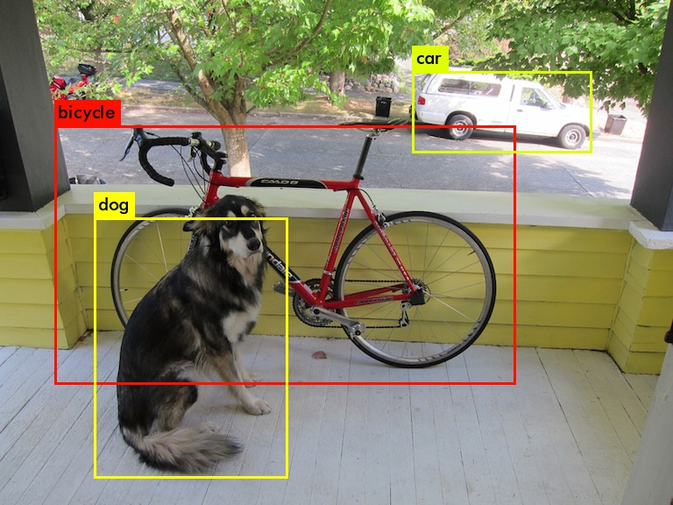
High-Level Vision
Semantics!
Image classification
Object detection
Segmentation
Applications
Retrieval
Robots?
and…????

Slide 44
Assignments
Build a vision library from the ground up
Mostly in C
Play with advanced tools, neural networks
Beginning: lots of skeleton code, explanations
End: less guidance, more experimentation
Tentatively 4 assignments (this may get cut down)

Slide 45
Collaboration
Do: talk to each other, ask for help, give help, explain concepts, talk about examples, google terms or concepts, lots of wikipedia!
Don’t: read other peoples code, copy code, search for code, etc.
Use any resource that helps you understand the material and concepts, don’t go looking for shortcuts around understanding just to finish an assignment. Submit all your own work.

Slide 46
Questions??
Github Classrooms

